Slide 1

Easy cure-online doctor consultation
1. Madhur Dukhande (20104014)
2. Aryan Amin (20104071)
3. Mayur Jain (20104024)
Project Guide
Ms. Geetanjali Kalme
Notes:
1

Slide 2
Contents
Introduction
Objectives
Scope
Literature Review
Proposed System
Project Outcomes
Block diagram
Case diagram
Technology Stack
Suggestions in Review-1
Result and Discussion
Conclusion and Future Scope
References
Notes:
2

Slide 3
1. Introduction
Easy Cure is an doctor consultation application which provides healthcare services to users. It provides a digital platform to bridge distance gap between the doctors and patients.
Problems Identified :
In the events of the recent lockdown, people stay at home. If someone gets ill, they had to stay inside home.
Doctors come at specific period of time at clinic/hospital and patients used to wait until they come.
Solution Proposed :
By online consultation, user can ask their health problems whenever they want.
In case of emergency, user can contact doctor at that time and does not need to go to hospital.
Notes:
3

Slide 4
2. Objectives
To provide priorities to patients reference.
To expand the coverage of services.
To give more comfort to patients.
To prevent illness in crowded areas.
Notes:
4

Slide 5
3. Scope
It is used in remote places.
User will get a 24 X 7 service.
User will be able to check the availability of doctors whenever they want.
Notes:
5

Slide 6
4.Literature review
YEAR | AUTHOR | TITLE | TECHNOLOGY STACK | OUTCOMES | DRAWBACKS
2015 | Mrs. Kathleen Gray | Online Medical Consultation | Database:inspec | It is highly cost-effective for patients who need regular doctor visits and works well in case of emergencies. | The majority of papers provided an evaluation of remote consultation use for a particular medical practice but not for a large group.
2018 | Mr. Arun Singh | Online Medical Assistant | Database: pub- Med | One of the advantages is that you do not have to wait in a clinic for the doctors.Instead you can submit the information and symptoms at any time. | If there is a failure to get communicate with the regular doctor,it is quite hard to get another doctor evalution of one’s medical issue.

Slide 7
5. Proposed System
Feature 1 :
Information about doctors and their specializations which will help patients for selecting doctor easily.
Feature 2 :
We have made website better and user friendly so patients and doctors will not face any issue.
Notes:
7

Slide 8
6. Outcome of Project
Provides quick registration facilities for both patients and doctors.
Search option for available online doctors in case of emergency.
Shows previous medical history for patients as well as medical background of doctors.
Free online support.
Notes:
8

Slide 9
7. Block Diagram
Start
Login Page
No
Registration Page
Yes
Home Page
Services
Departments
Doctors
Video Chat
Reviews
About Us
Contact Us Page
Make an appointment
End
Notes:
9

Slide 10
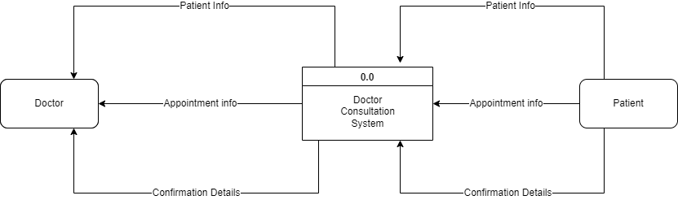
8. DFD
0 Level DFD

Slide 11
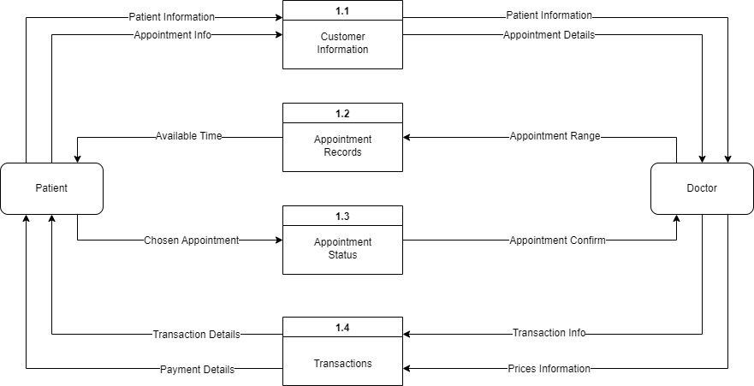
8. DFD
1st Level DFD

Slide 12
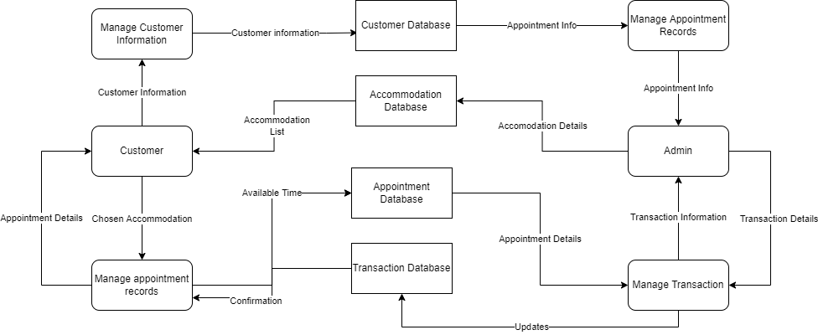
8. DFD
2nd Level DFD

Slide 13
9. Technology Stack
Frontend:
HTML
CSS
Javascript
Backend:
Firebase
PHP
Notes:
13

Slide 14
10.Suggestions in review-1
Video calling
Customer review add
FAQ

Slide 15
11.Result and Discussion
Result:
The application can be used for any online medical checkup application It is easy to use, since it uses the GUI provided in the user dialog. User friendly screens are provided. The application is easy to use and interactive making online consultation for users. It has been thoroughly tested and implemented.

Slide 16
12. Conclusion & Future Scope
Conclusion:
This E-Health environment will focus on patients health and provide flexibility to any emergencies. Henceforth providing an excellent platform for healthcare.
Future Scope:
Medical Records: Patient’s previous medical reports can be checked.
New Doctors:
New Doctors can join our platform if he/she meets the necessary conditions set by our panel for the required specialization.

Slide 17
References
[1]. Bailey, N. (1952). A study of queues and appointment systems in hospital outpatient
departments, with special reference to waiting times. Journal of the Royal Statistical Society, A14,
185-199.
[2]. Klassen, K. J., T. R. Rohleder. 2004. Outpatient appointment scheduling with urgent clients in a
dynamic, multi-period environment. Internet. J. Service Indust. Management 15(2) 167–186.
[3]. Marynissen, J., & Demeulemeester, E. (2018). Literature review on multi-appointment
scheduling problems in hospitals. European Journal of Operational Research.
[4]. Maryam Tufail (2018-08). Master’s thesis on “Online polyclinic appointment and database
management System.
[5]. Alex Chaffee (2000-08-17). "What is a web application (or "webapp")?". Retrieved
2008-07-27.

Slide 18
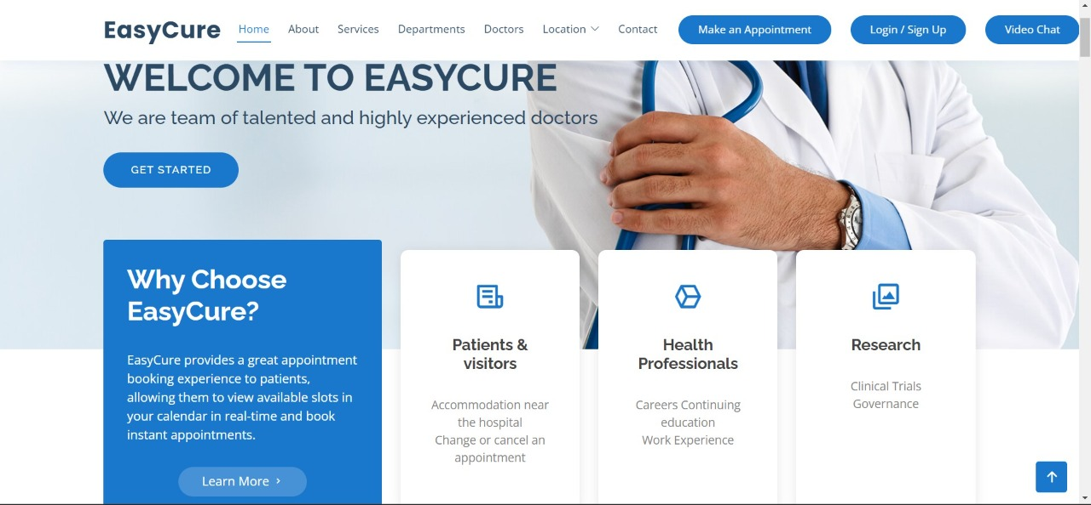
Home page:

Slide 19
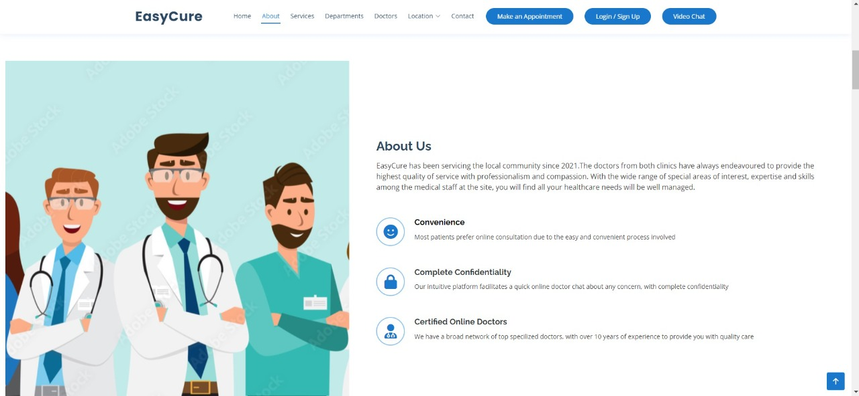
Home page:

Slide 20
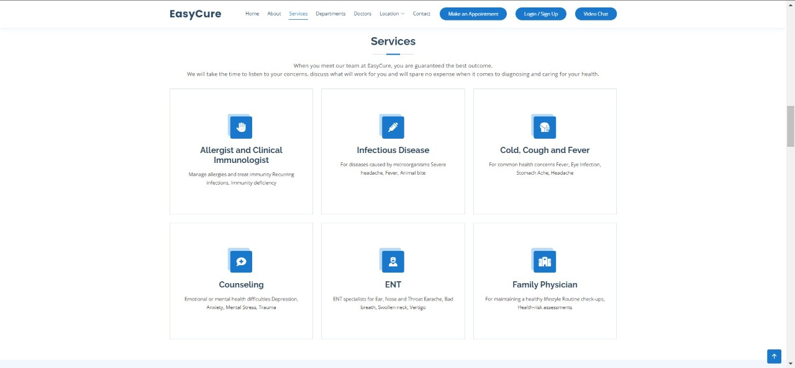
services:

Slide 21
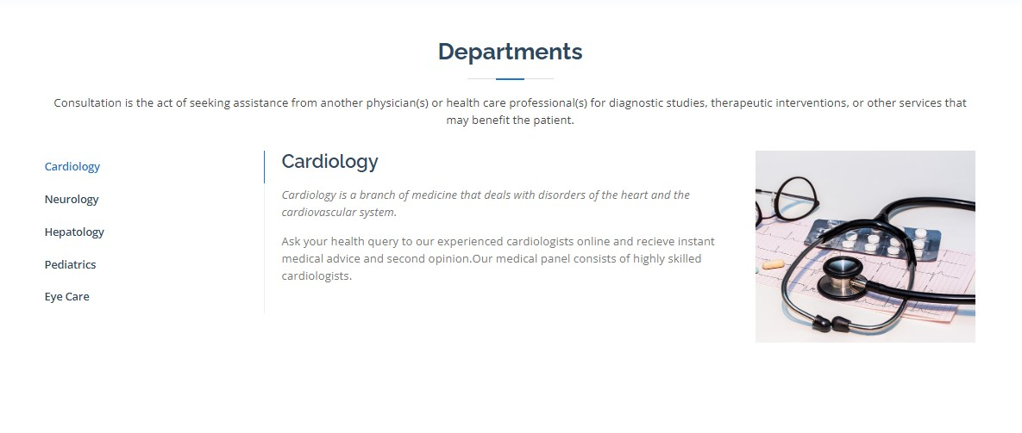
Departments:

Slide 22
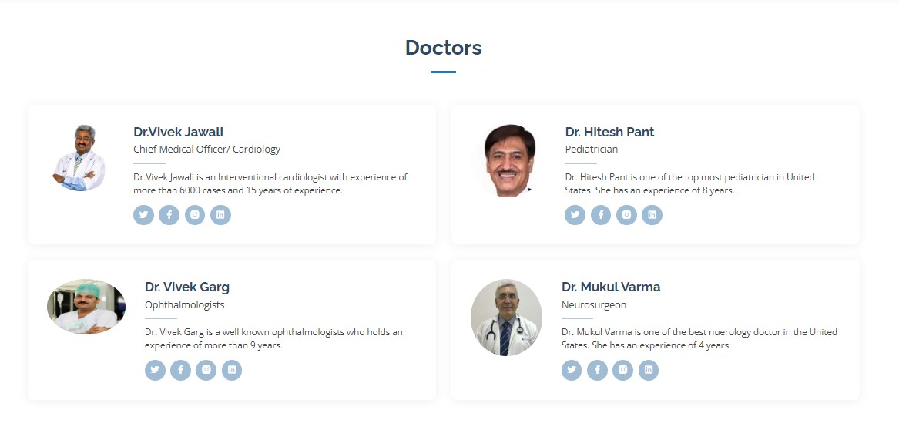
Doctors:

Slide 23
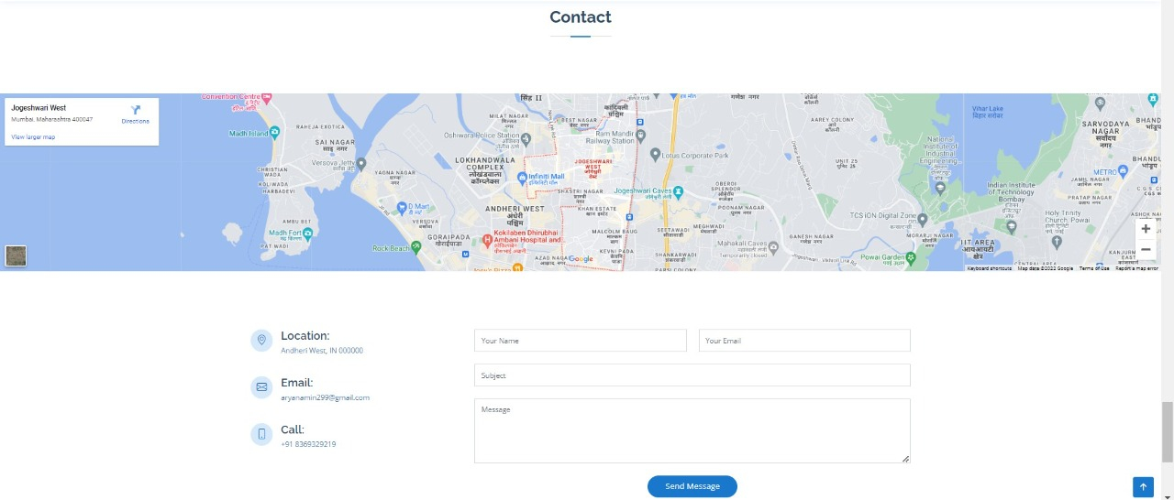
Contacts:

Slide 24
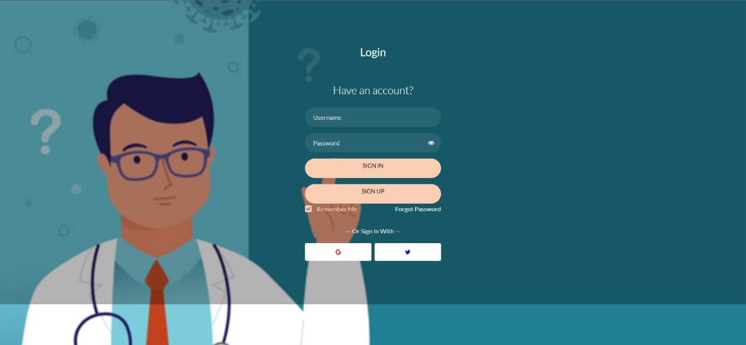
login page:

Slide 25
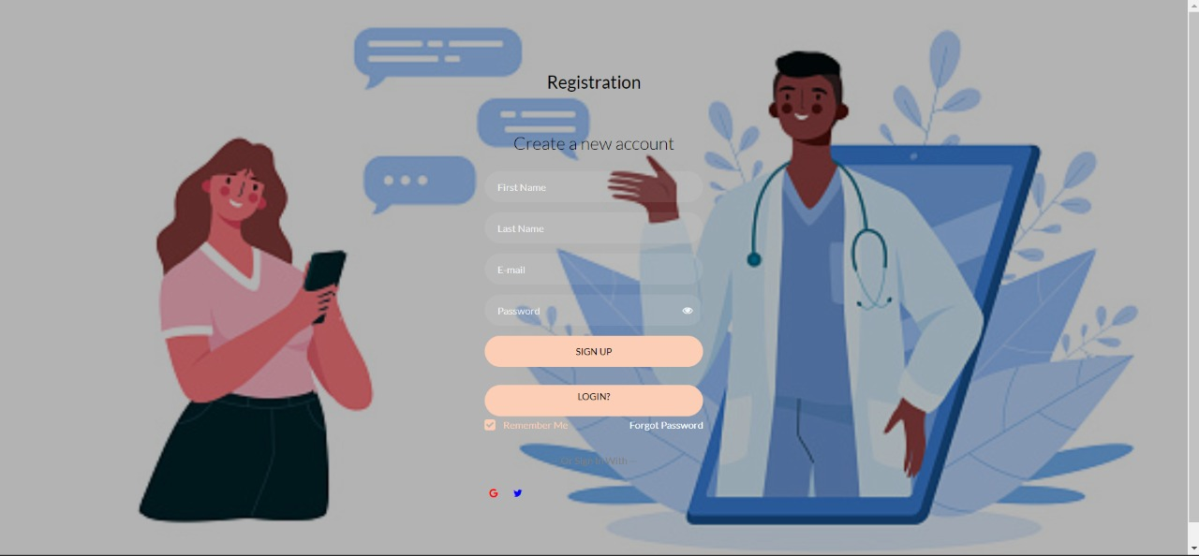
Sign up page:

Slide 26
Thank You...!!
Notes:
26

